Slide 1
WEEK 5 PROGRESS REPORT

Slide 2
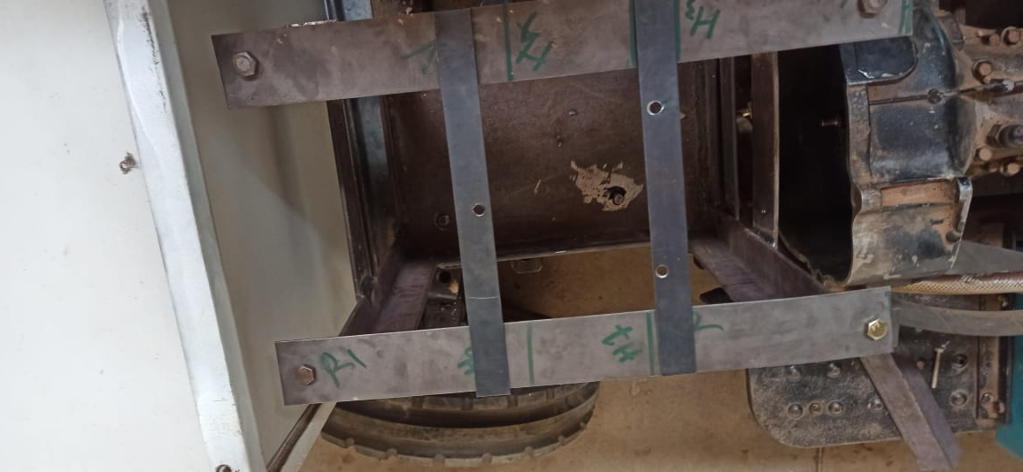
FABRICATION OF FAN MOUNT
The fan mount fabrication and installation was completed

Slide 3
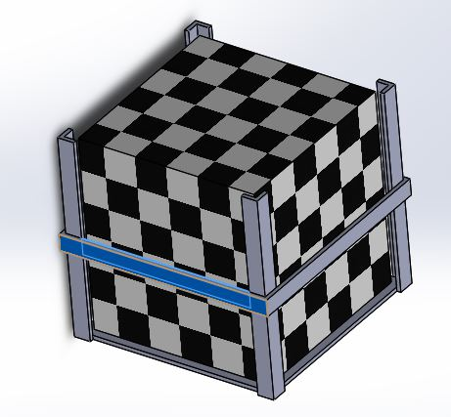
BATTERY MOUNT DESIGN
The design was completed as shown below

Slide 4
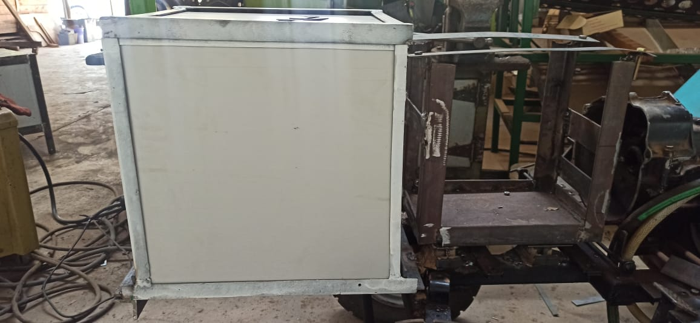
BATTERY MOUNT FABRICATION AND INSTALLATION
The battery was installed with its casing for safety purposes and to minimise on material usage as shown

Slide 5
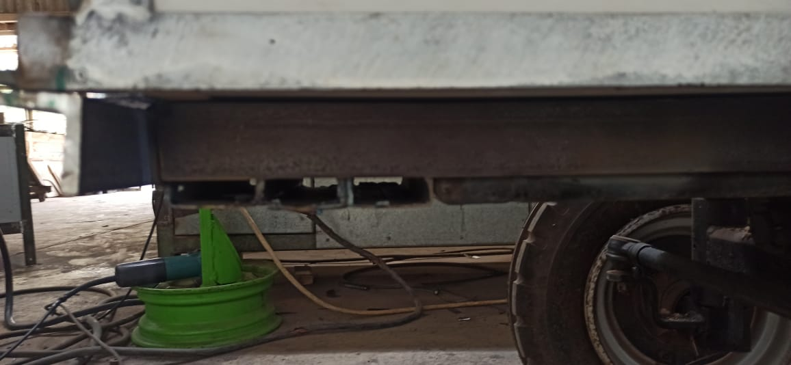
EXTENSION OF THE CHASIS
The chassis was extended using a boxshaft to prevent the battery from overhanging.

Slide 6
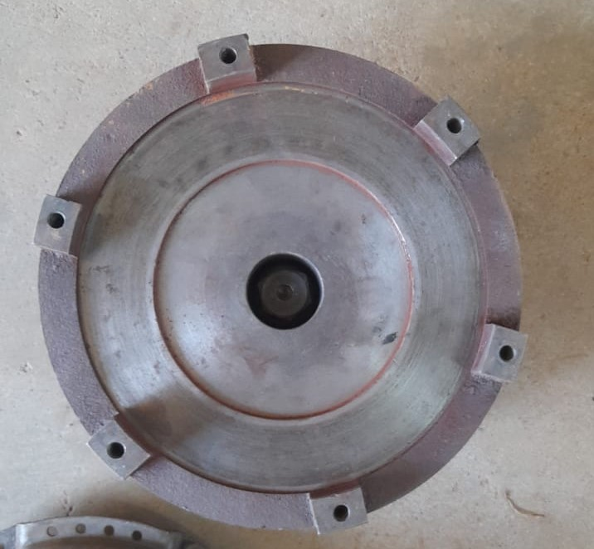
ACQUISITION OF THE FLY WHEEL
The flywheel was unmounted from one of the Shujaa tractors in the BEED workshop as shown

Slide 7
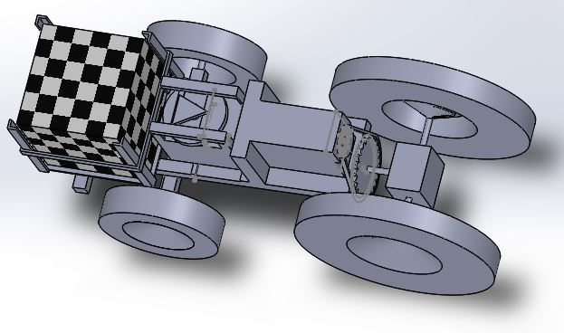
3D CAD REPRESENTATION

